Slide 1




WELCOME TO THE
PRE PRIMARY VIRTUAL
RECITATION COMPETITION
(2020-21)
Notes:
WELCOME TO THE VIRTUAL

Slide 2

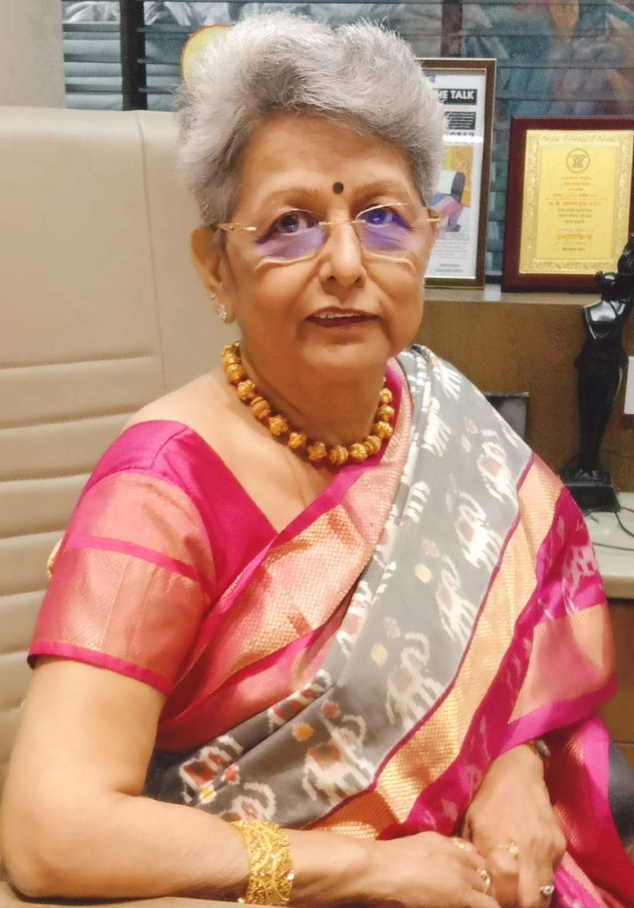

Chairperson & Administrator
Mrs. Meera Korde

Slide 3

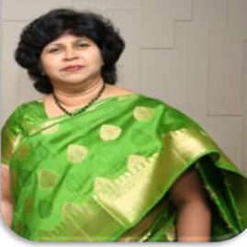
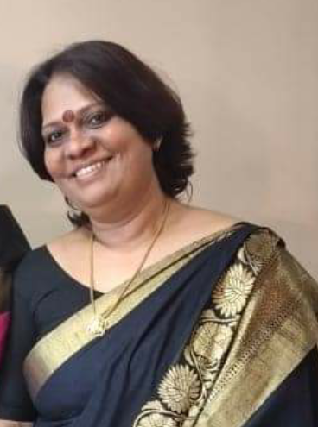
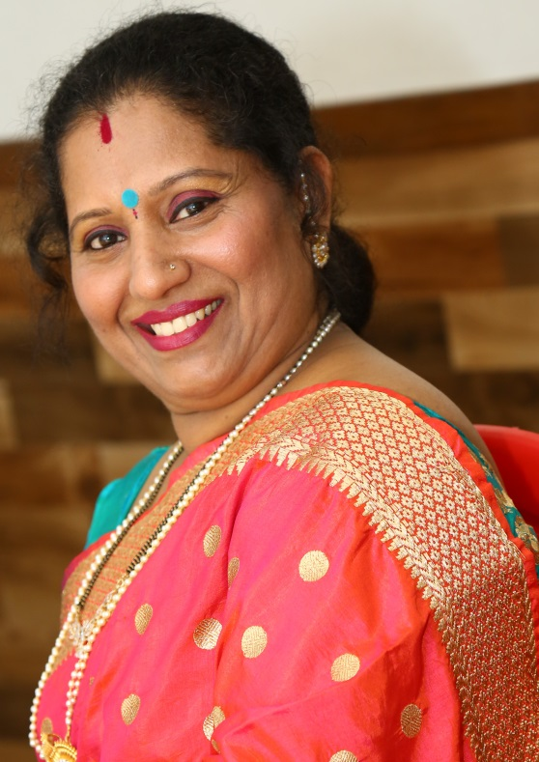
OUR WONDERFUL PILLARS OF SVPT
PRINCIPAL
Mrs. Anita Pinto
VICE PRINCIPAL
Mrs. Manju Mishra
CO ORDINATOR
Mrs. Meenakshi Bangera

Slide 4


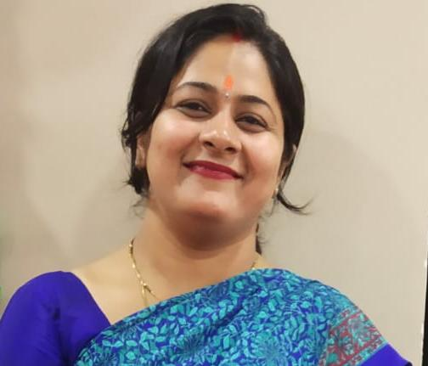
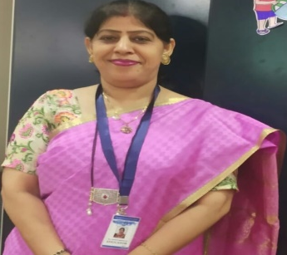
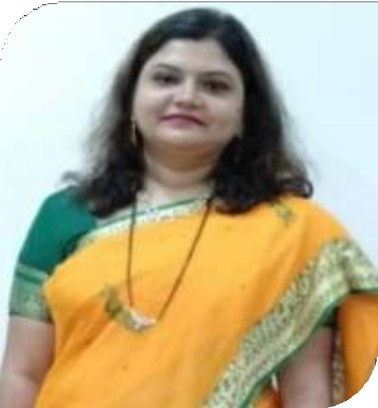
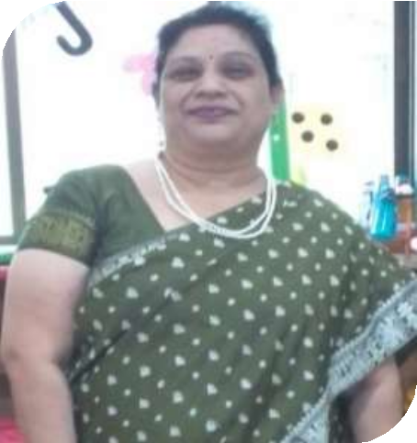
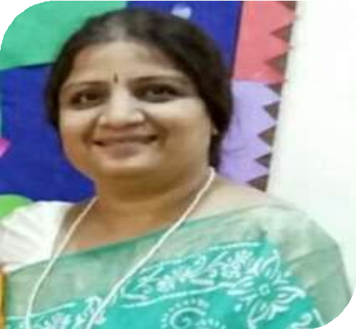
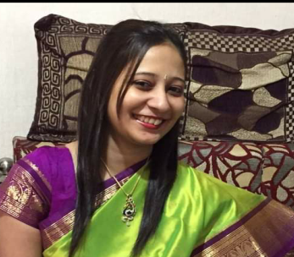
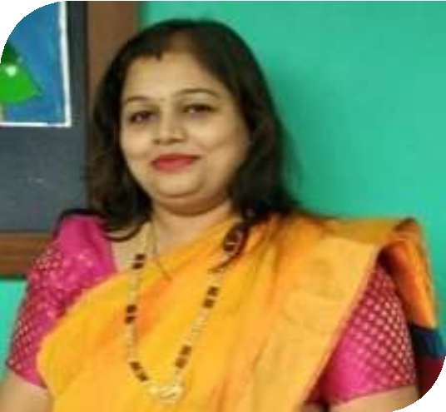
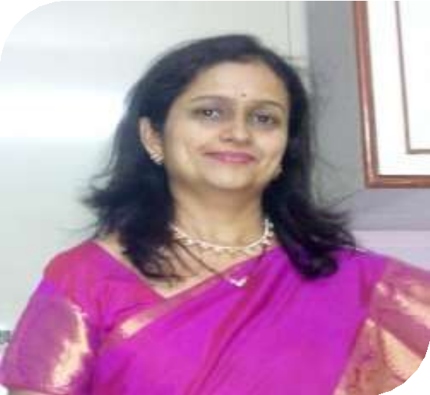
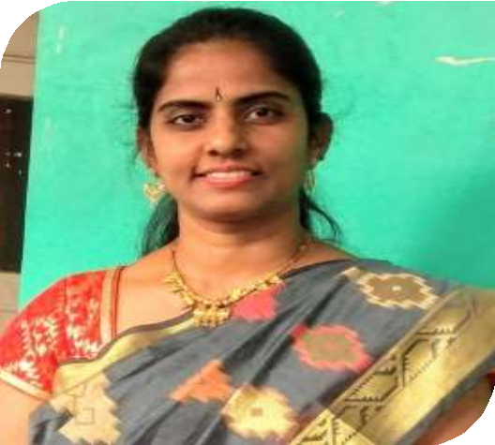
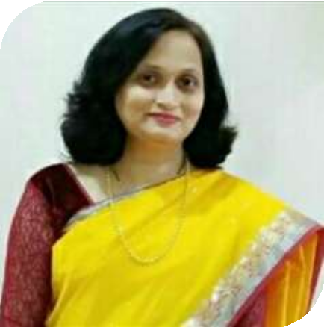
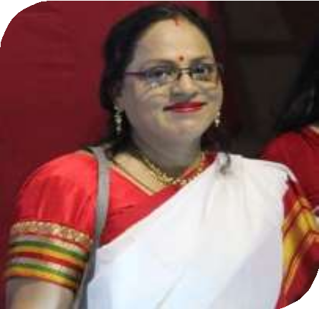
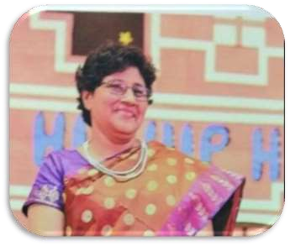
SUCCESS OF ANY EVENT IS NOT POSSIBLE WITHOUT THE DEDICATION AND HARD WORK OF THE TEACHERS….
Mrs.Sangita Tiwari Mrs.Bharti Mudaliar
Mrs.Priyadarshani J Mrs Paramjeet More Ms.Shalini Naik Mrs Gautami E Mrs Pallavi Bhoi
Mrs.Jyoti H.
Mrs.Sheela Vinod.
Mrs.Mamta P.
Mrs.Annapurna
Mrs.Angela D’souza

Slide 5


JR.KG WINNERS
WINNERS

Slide 6


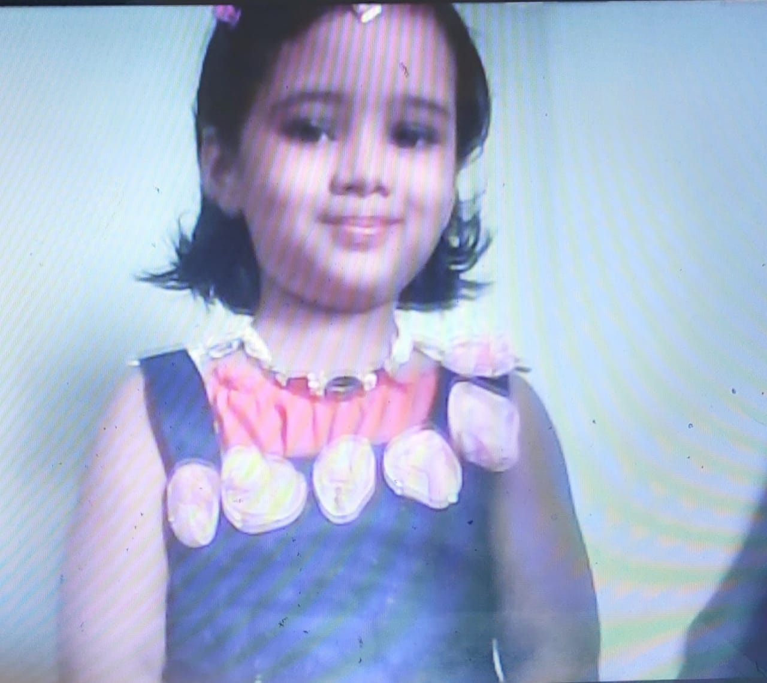
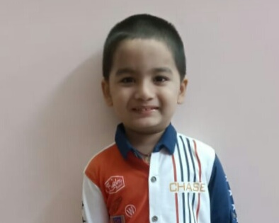
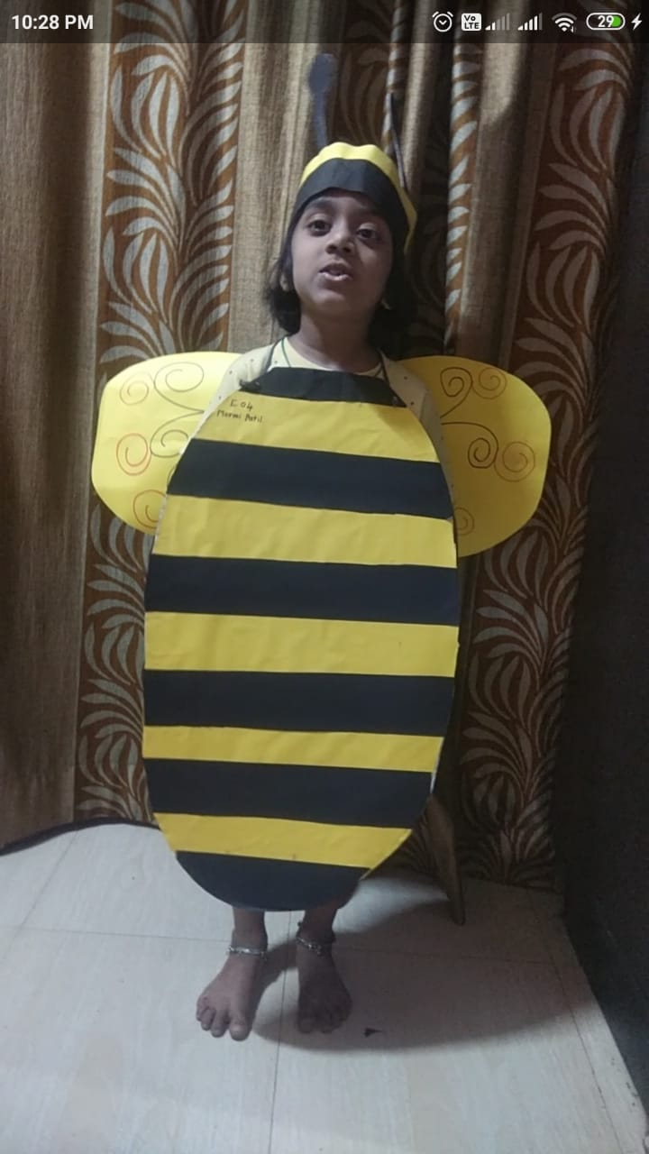
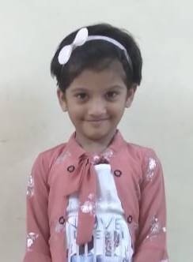
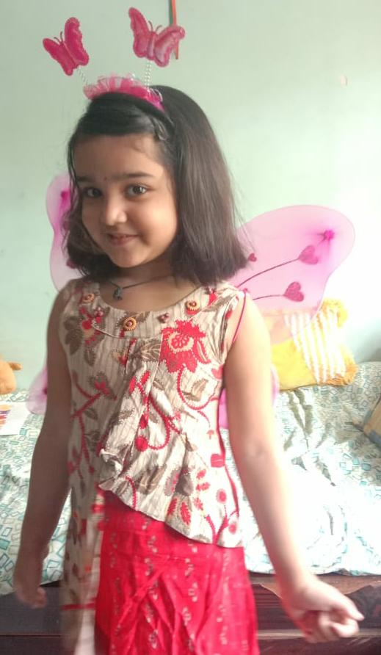
WINNERS
1ST PRIZE
MS. URVI PATIL
MST. KANISHK MALGUNDKAR
MS. MARMI PATIL
MS. NABHA KAJALE
MS. SANIDHYA MHATRE
Notes:
MS. URVI PATIL

Slide 7
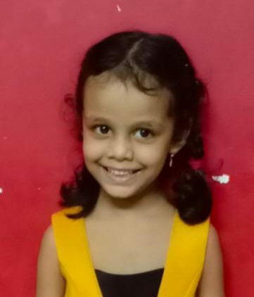
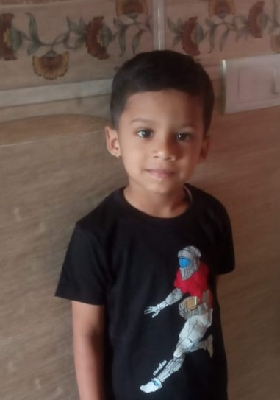
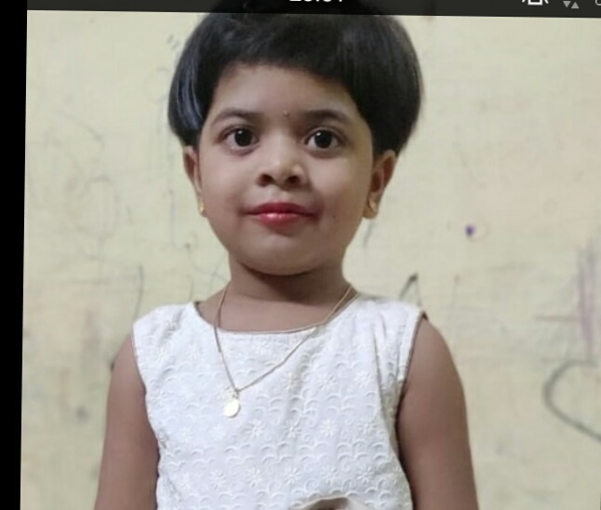
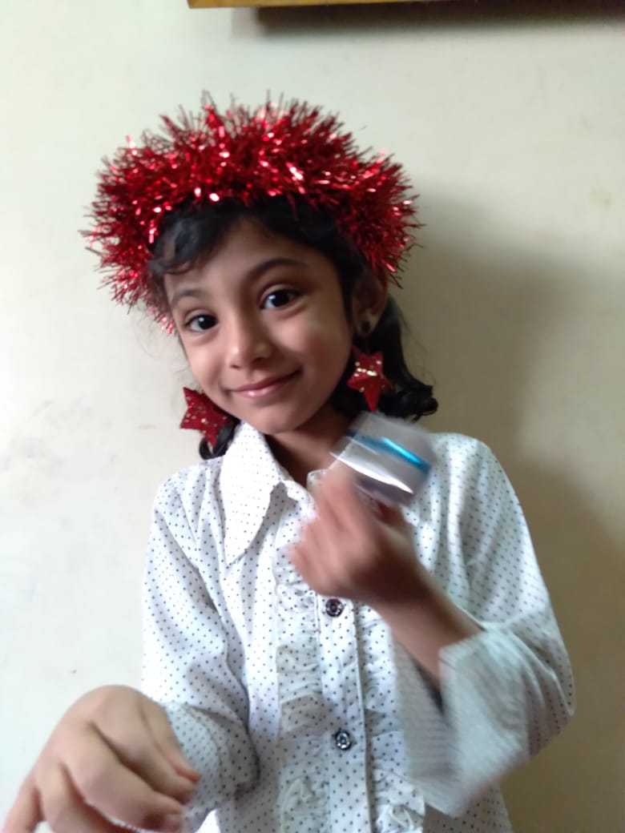
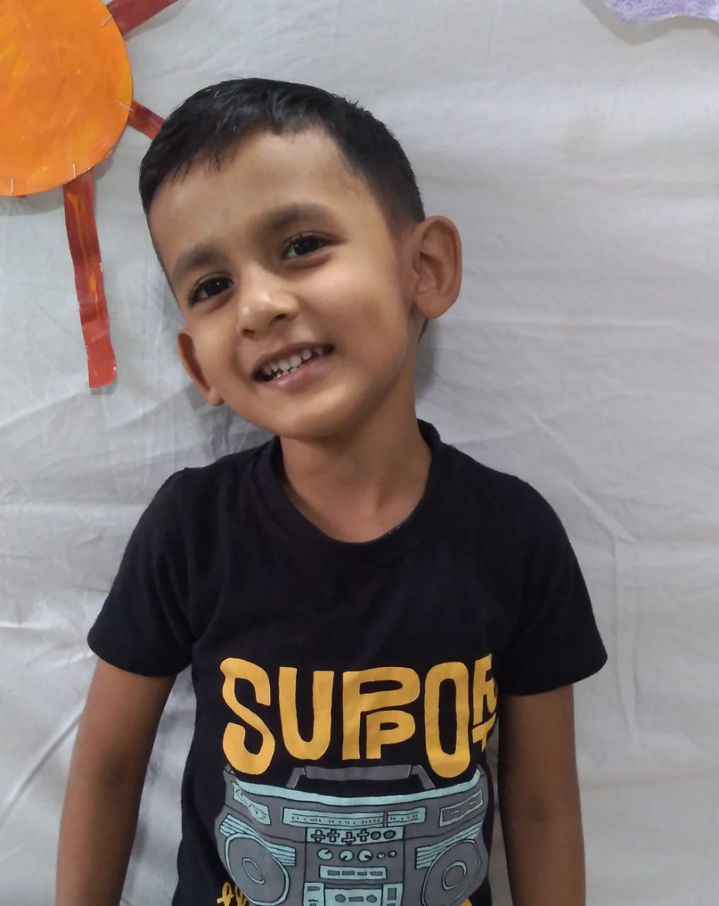
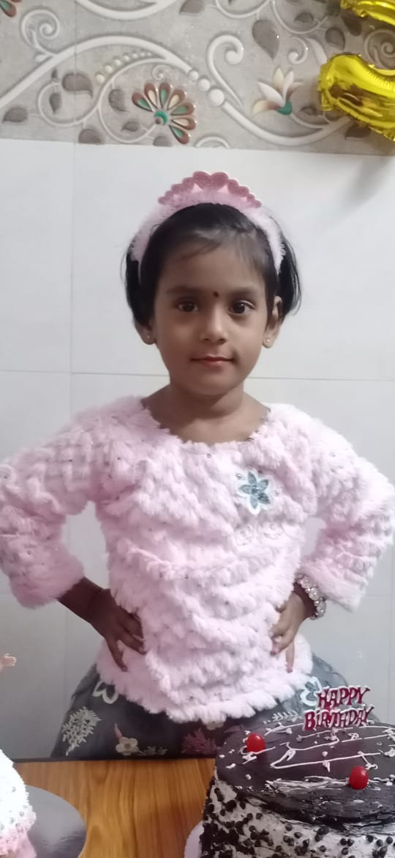
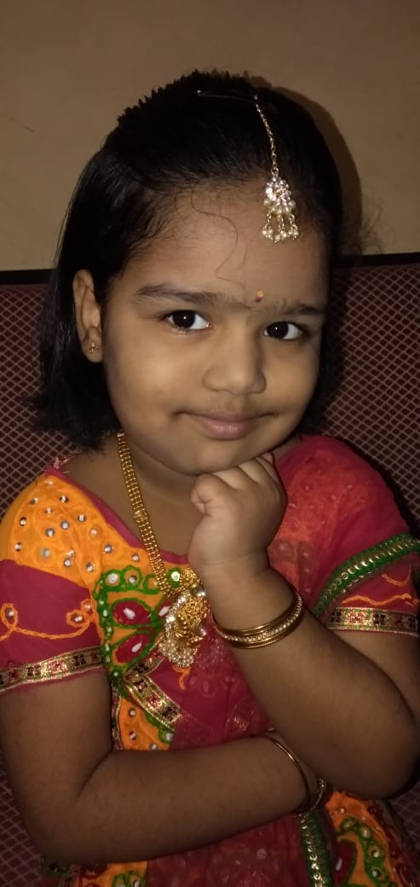
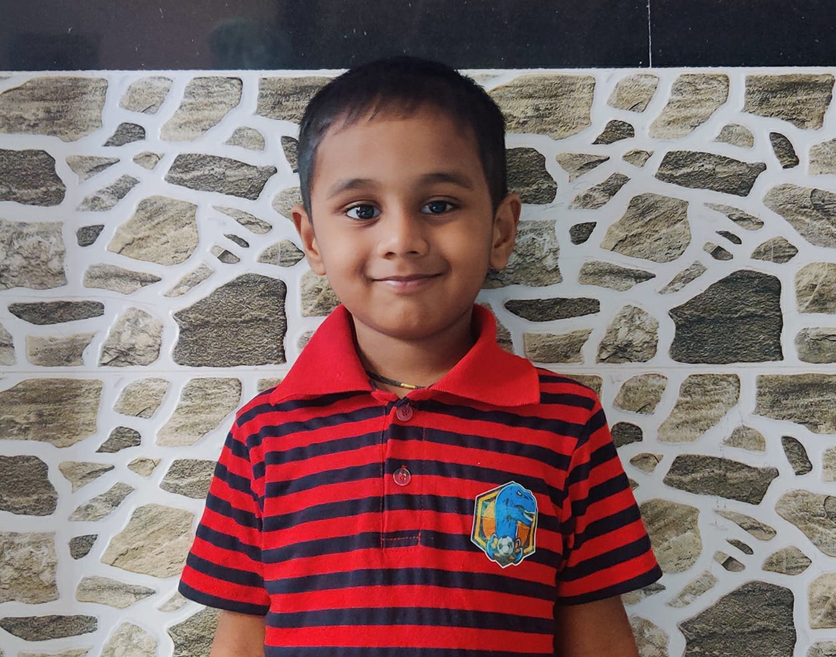
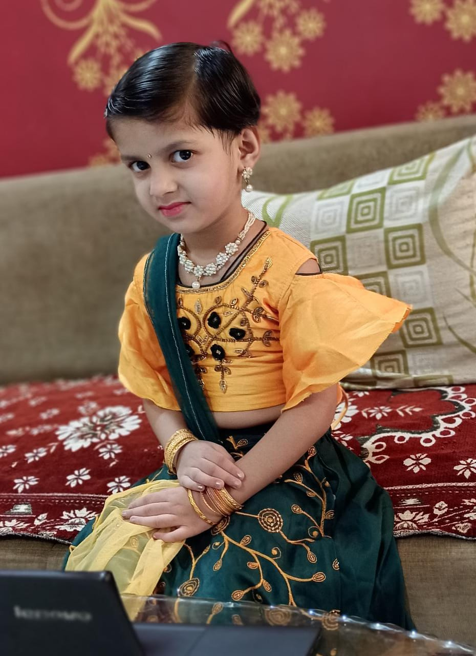
WINNERS
2ND PRIZE
MS. MRUNAL KUBAL
MST.AARADHY PIMPLE
MS. DHRUVI BHATKAR
MS. ZAINAB THANAWALA
MST. SHAURYA NIMBALKAR
MS. SHARAYU MAGDUM
MS. AVANI SALUNKHE
MST. SWARAJ FARAKTE
MS. VIBHA BORSE
Notes:
MS. URVI PATIL

Slide 8


OUR JR.KG. PRIZE WINNERS……..
1. MRUNAL KUBAL
2. LAKSH KOLI
3. RIYANSH LAD
4. AARADHY PIMPLE
5. URVI PATIL
6. KANISHK MALGUNDKAR
7. ZAINAB THANAWALA
8. MIHIR BHOGATE
9. PRISHA GAIKWAD
10. DHRUVI BHATKAR
11. AVANI SALUNKE
12. NABHA KAJALE
13. PRUTHA PARAB
14. ALAM RAWAL
15. SHARAYU MAGDUM
16. SWANANDEE PATIL
17. SHAURYA NIMBALKAR
18. KAVYA SHELKE
19. PREESHA PANWAL
20. SANIDHYA MHATRE
21. SIYA BIRWATKAR
22. VIRAJ GHADE
23. VIBHA BORSE
24. MARMI PATIL
25. SWARAJ FARAKTE

Slide 9
SR.KG WINNERS
WINNERS

Slide 10
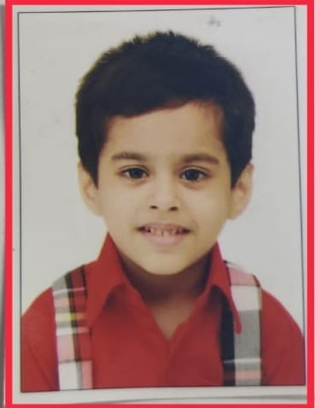
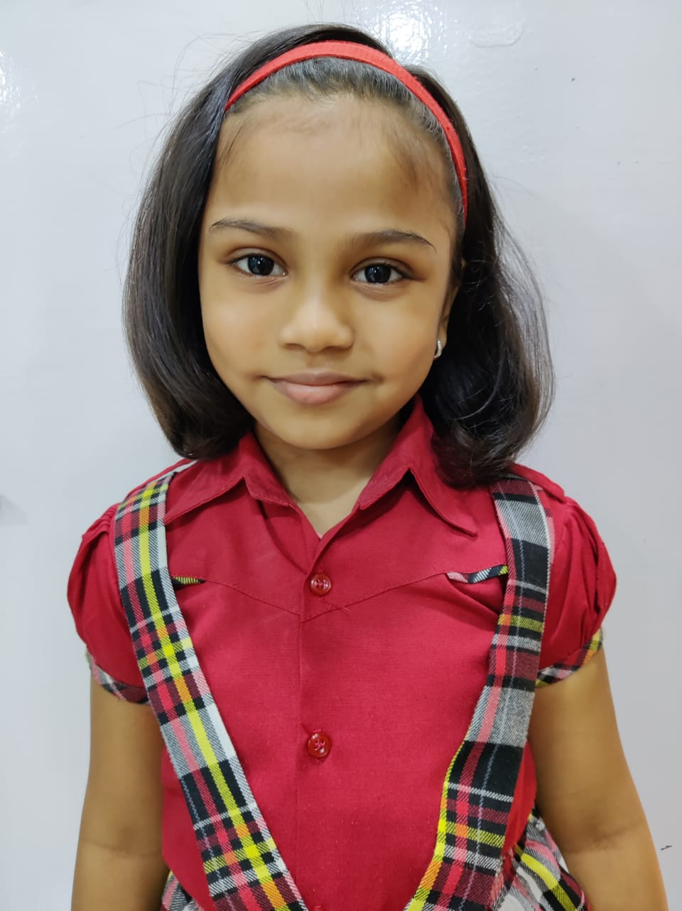
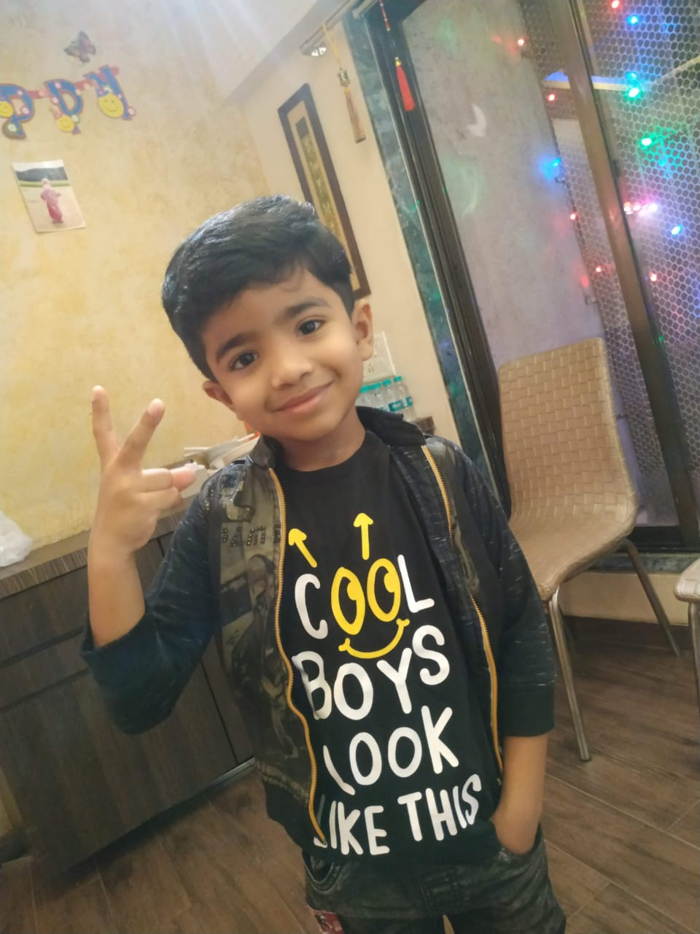
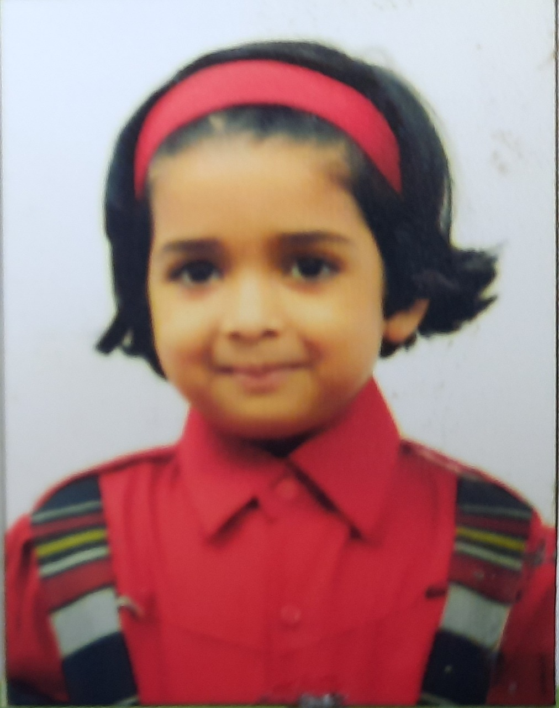
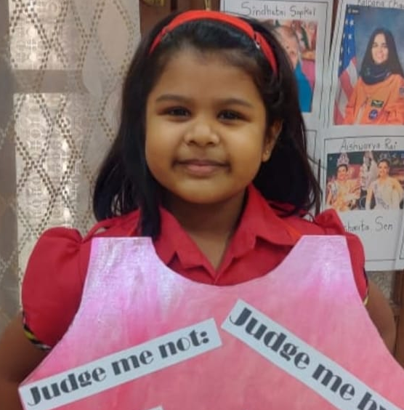
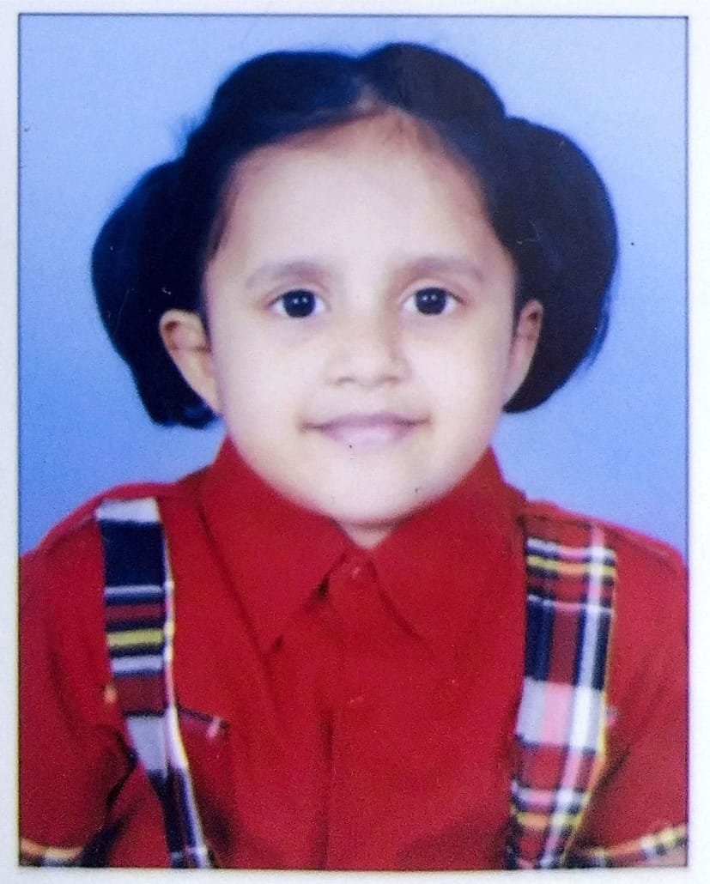
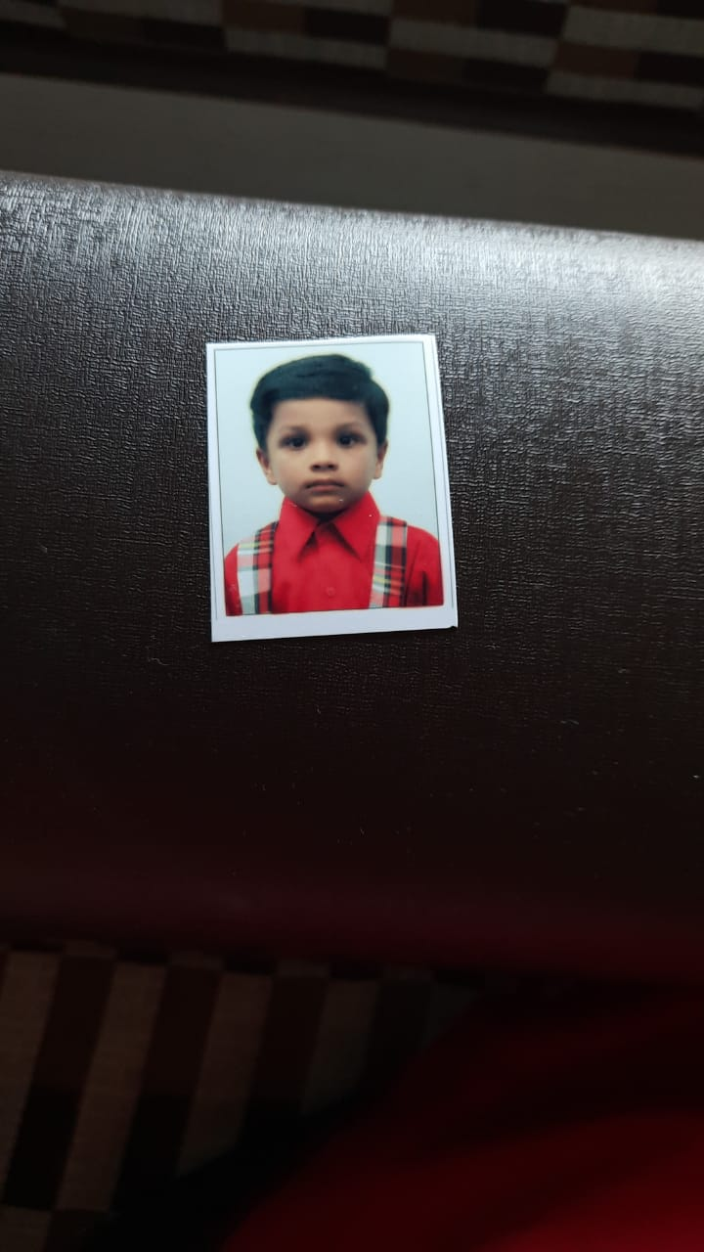
WINNERS
1ST PRIZE
MST. YASH KATHURIA
MS. SABURI UTEKAR
MST. VIHAAN SHINDE
MS. JIYA PUTHRAN
MS. ARNAVI PATIL
MS. SWARA PAWAR
MST. VIVAAN JAISWAL
Notes:
MS. URVI PATIL

Slide 11
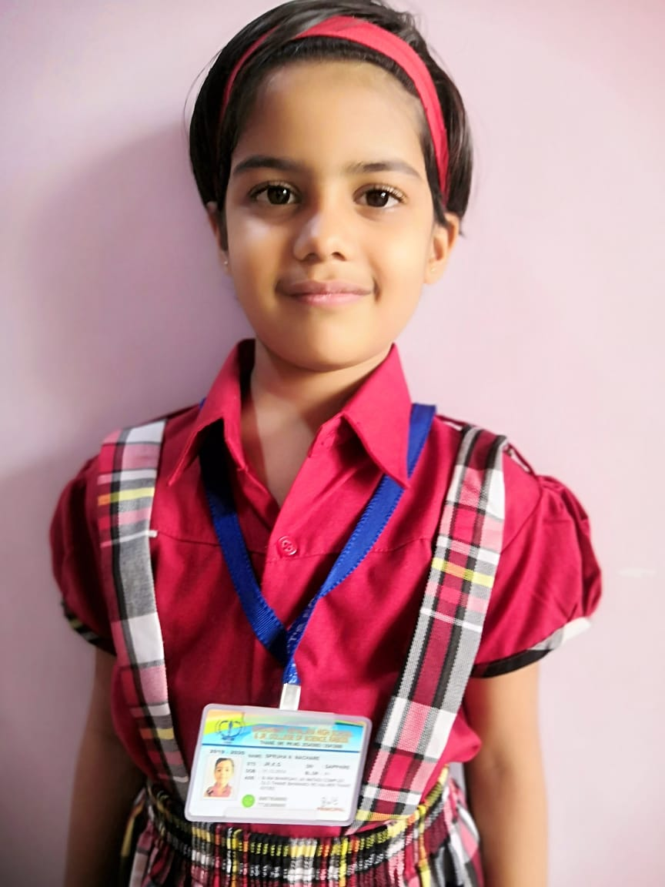
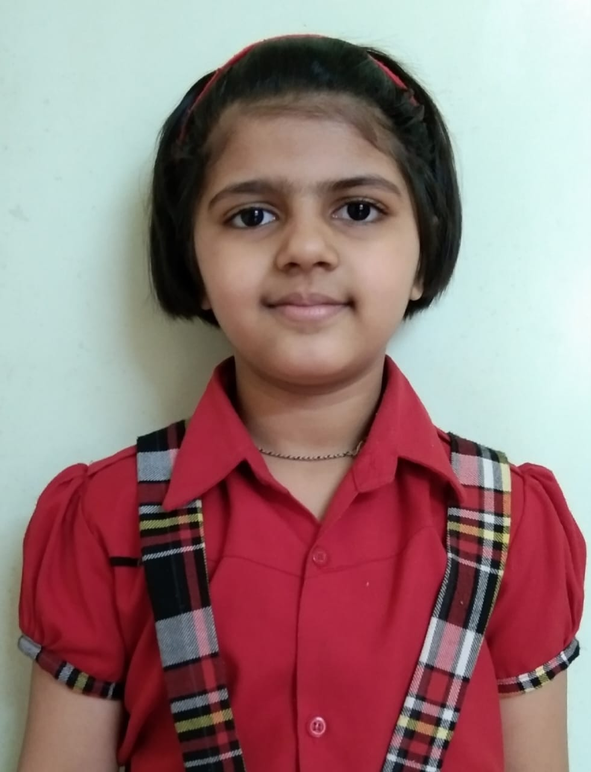
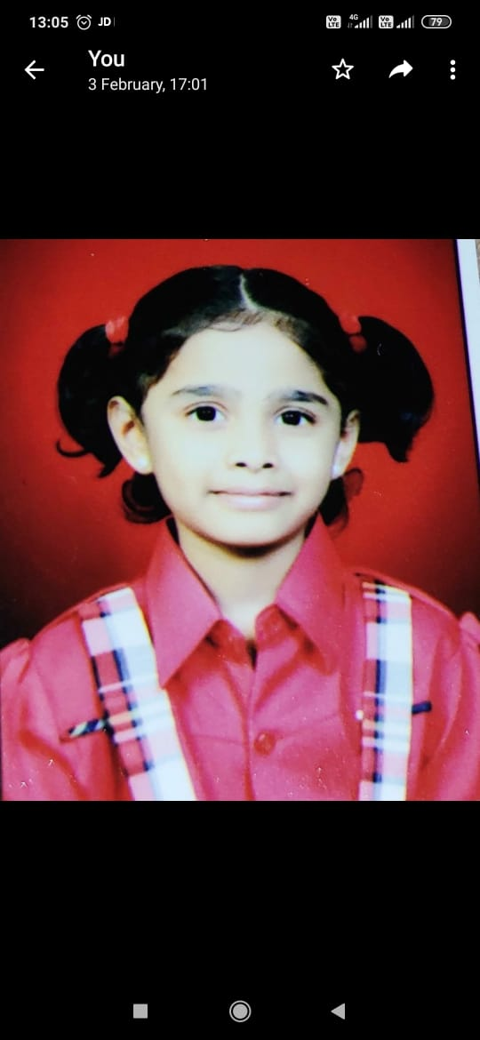
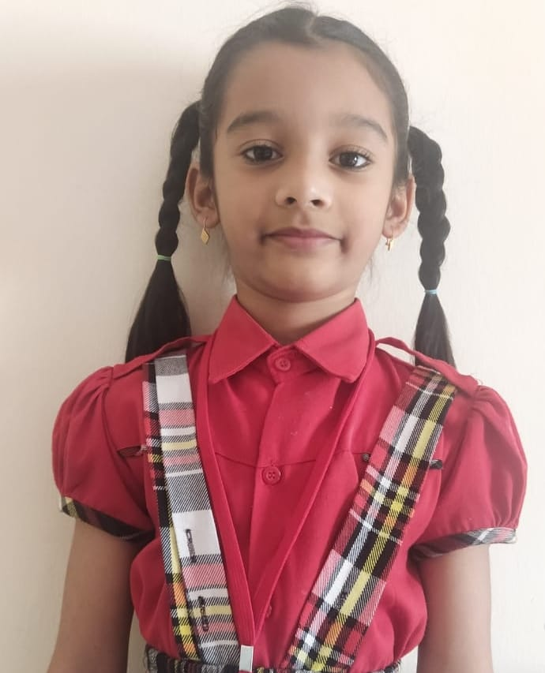
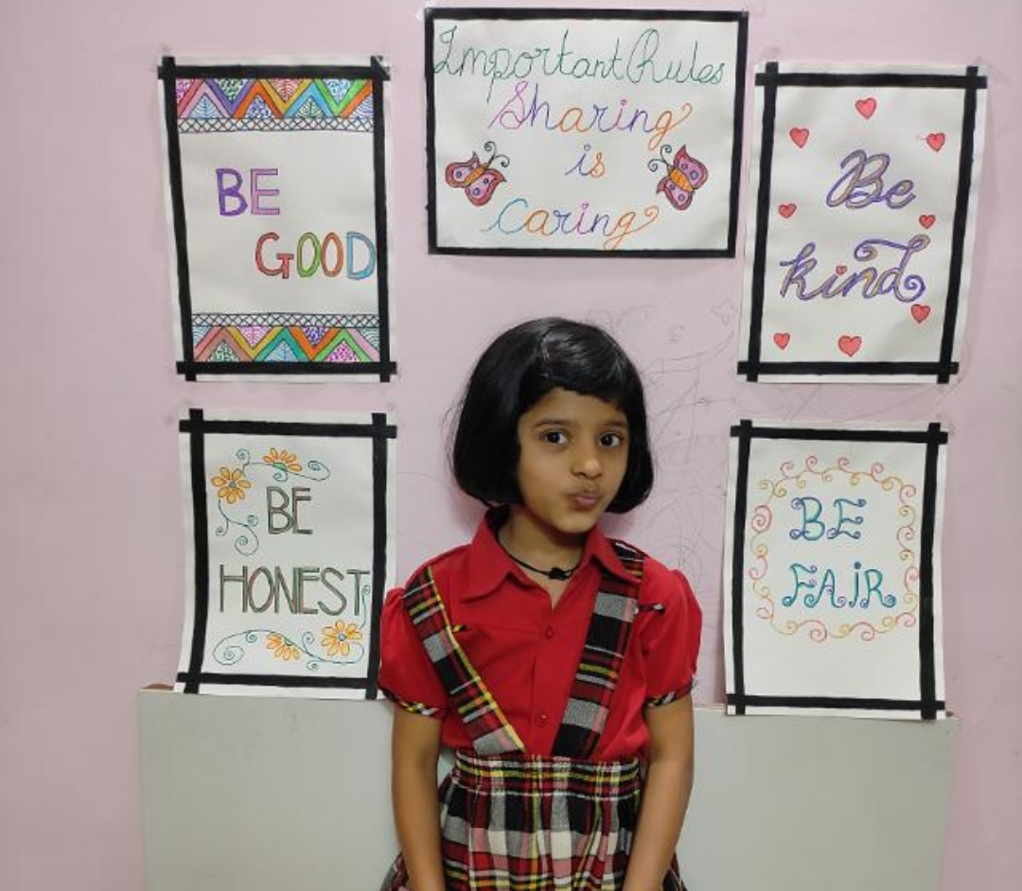
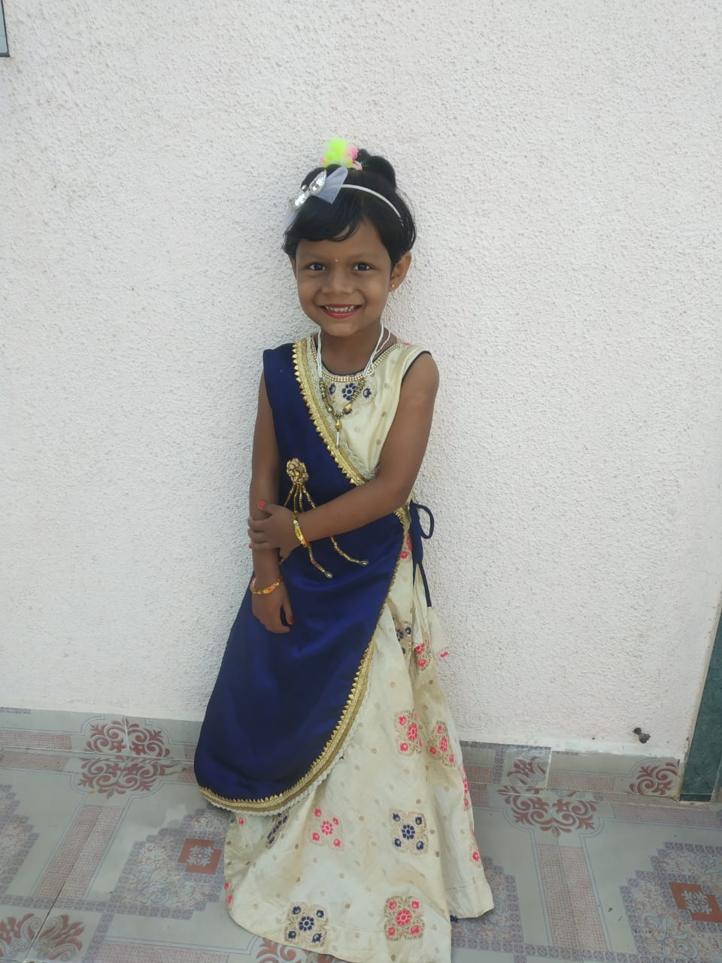
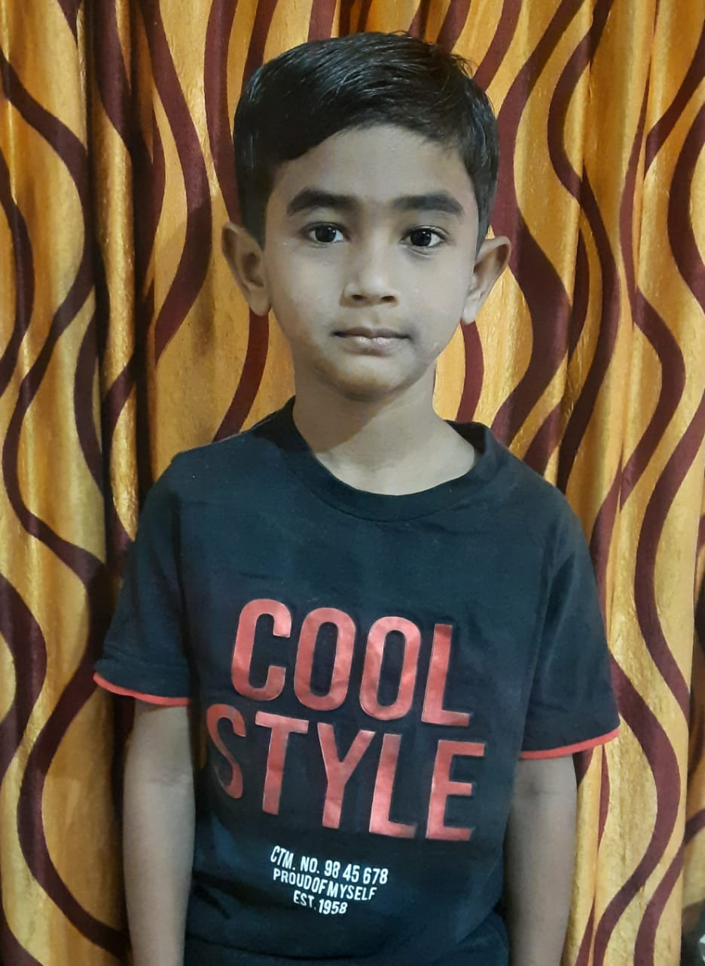
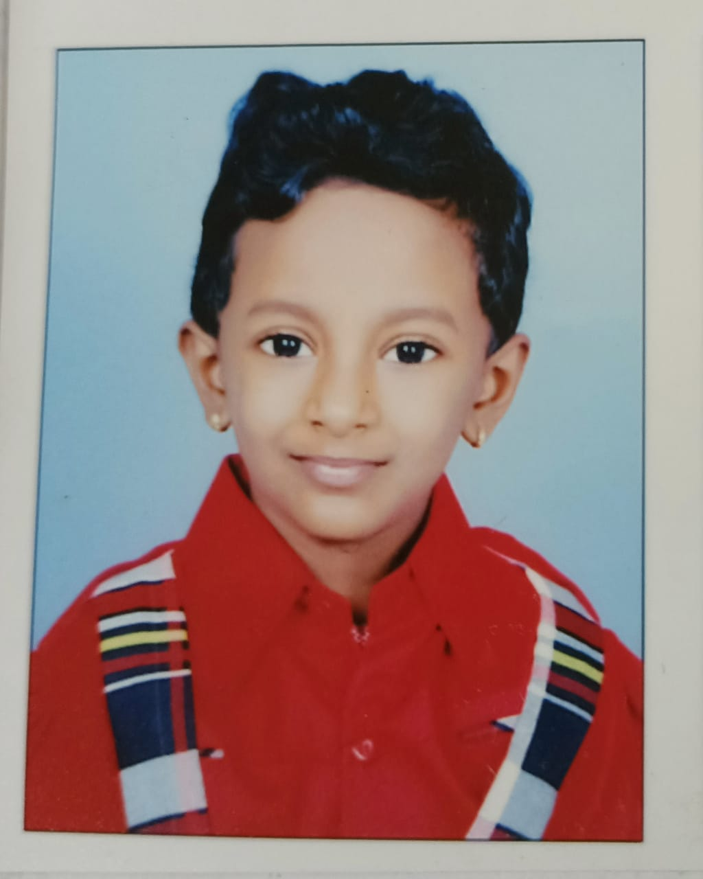
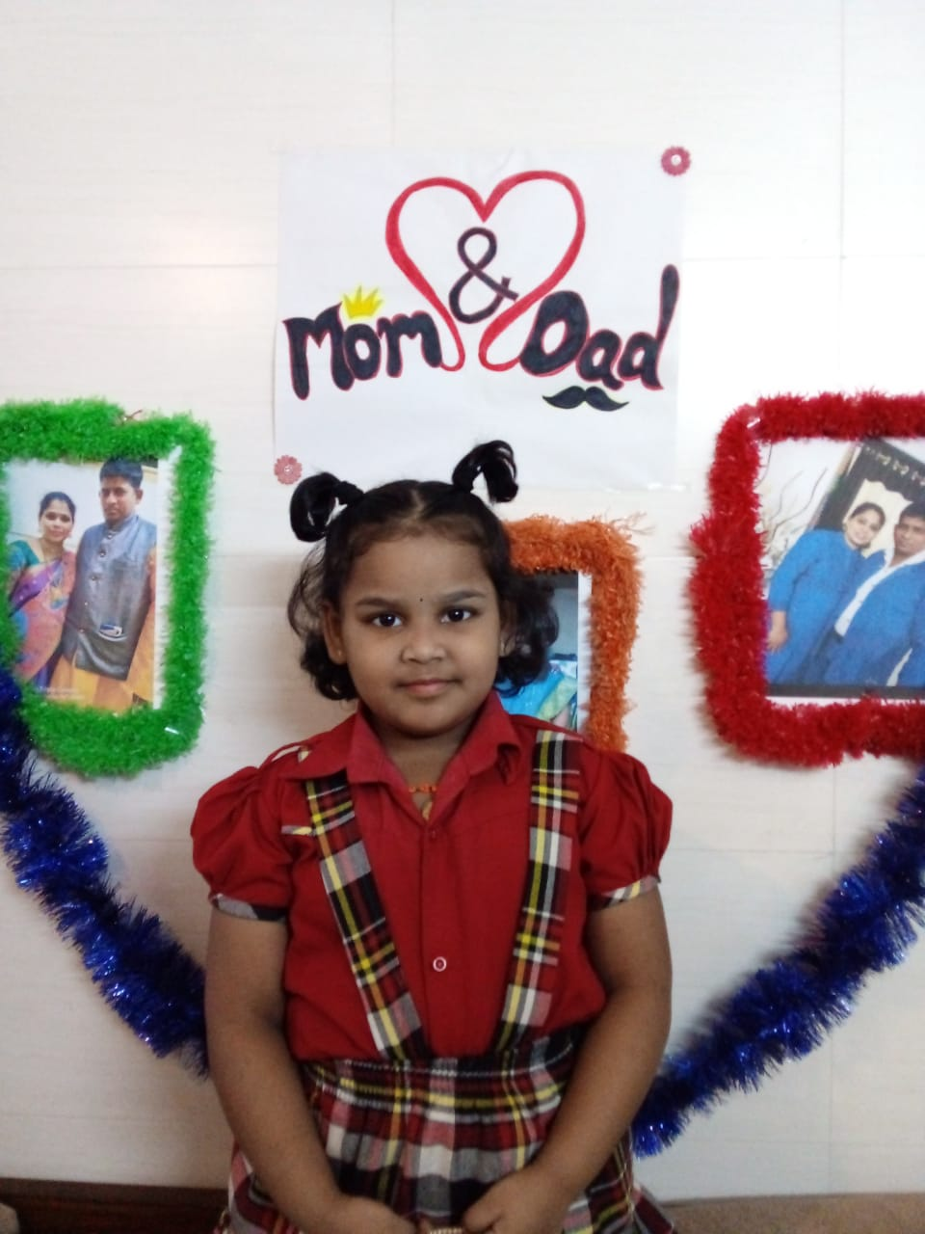
WINNERS
2ND PRIZE
MS.SPRUHA NACHRE
MS. SWARA KADAM
MS. HITIKSHA SONSURKAR
MS. INAYA KHAN
MS. ANANYA GHADIGAONKAR
MS. SWARA VEER
MST. SHREYANK PABALE
MS.JAISHNAVI DESPANDE
MS. DIVIJA DABHOLKAR
Notes:
MS. URVI PATIL

Slide 12

OUR SR.KG PRIZE WINNERS…..
1. SPRUHA NACHRE
2. YASH KATHURIA
3. SWARA KADAM
4. SANKALP MISAL
5. HITISHKA SONSURKAR
6. INAYA KHAN
7. YUKTA SALEKAR
8. SABURI UTEKAR
9. KAIVALYA GAVIT
10. JIYA PUTHRAN
11. ANANYA GHADIGAONKAR
12. ARNAVI PATIL
13. NAIHRUTYA NALAWADE
14. AHMED FAQUIH
15. JAISHNAVI DESPANDE
16. SWARA PAWAR
17. VIVAN JAISWAL
18. DIVIJA DABHOLKAR
19. KAVYA GOLATKAR
20. SHREYANK PABLE
21. VIHAAN SHINDE
22. DHAIRYA CHAVAN
23. SWARA VEER
24. RAJAS DHANAWADE

Slide 13

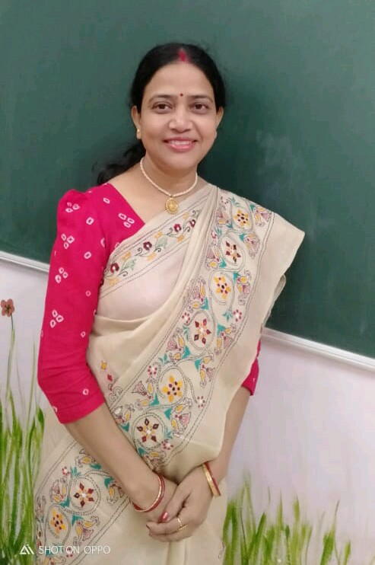
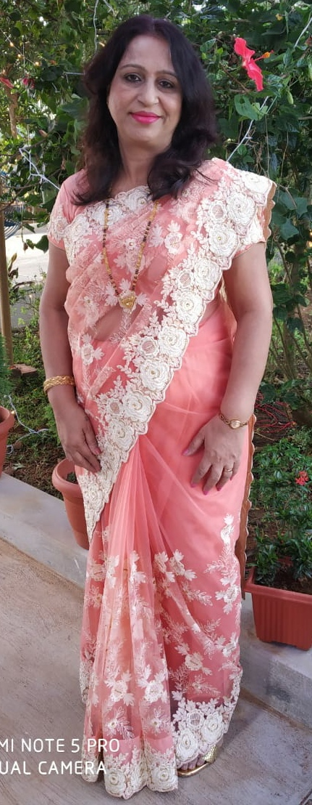

JUDGES
MRS. SARAMA DHARGUPTA
MRS. SHARMILA D’SOUZA

Slide 14
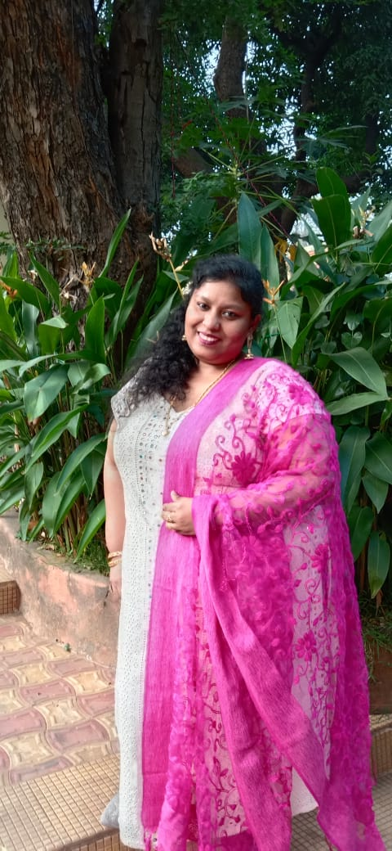
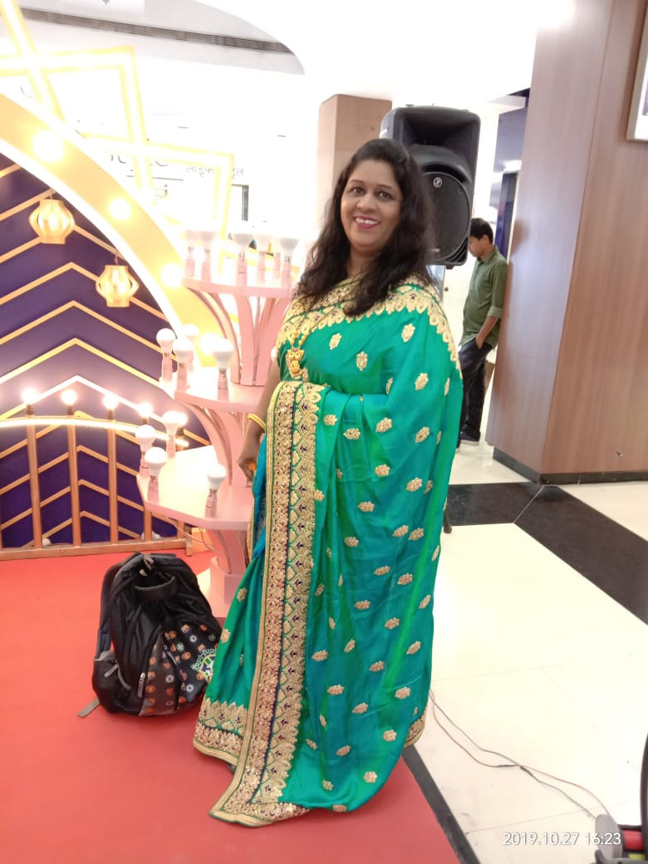
JUDGES
MS. FLAVI FERNANDES
MRS. SAYLI TAMBEWAGH

Slide 15


